Slide 1



Even I can make a website now!

Slide 2



Customers

Slide 3
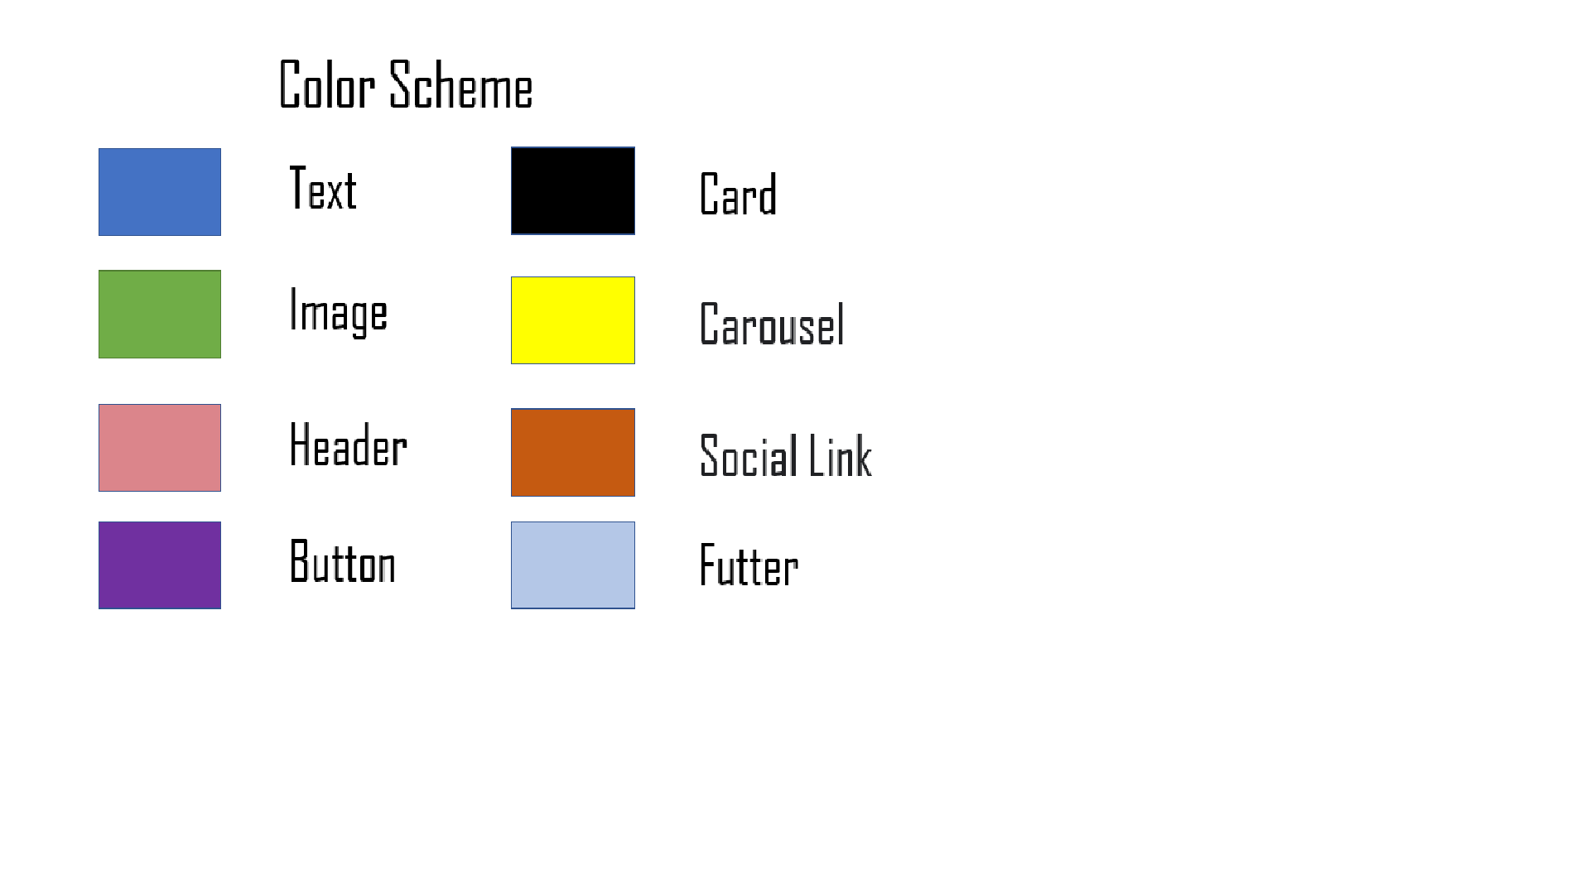

Innovation

Slide 4







DevOPS
FRONT END
BACK END
Why Docker?
Why Conteinarization?

Slide 5
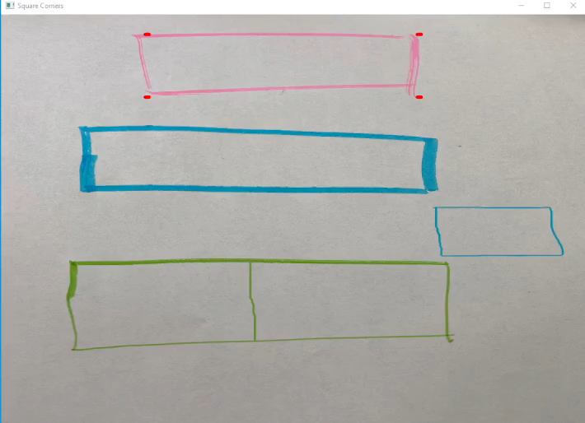

Slide 6
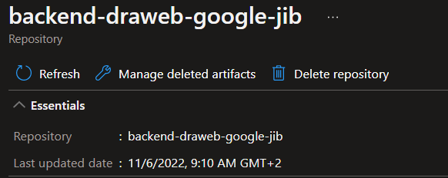
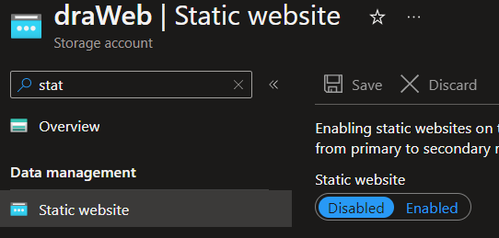


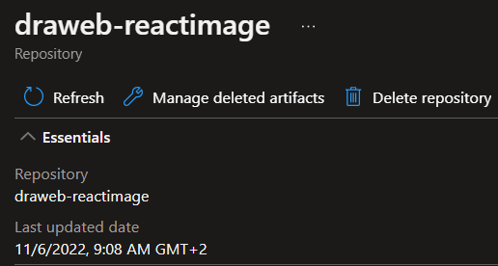
CLOUD Native

Slide 7





What the future holds
First phase
Azure Cache for Redis
Kubernetes Cluster
Monitoring Alerting

